Slide 1

NPTEL
Applied Accelerated Artificial Intelligence
Instructor: Dr. Satyajit Das
Dept. of Computer Science and Engineering
Indian Institute of Technology Guwahati, Assam, India

Slide 2
Week 01: AI System Hardware & Accelerators
Segment 1: CPU Architecture | Segment 2: Memory Hierarchy | Segment 3: GPU & Accelerators | Segment 4: Interconnects | Segment 5: AI Software Stack

Slide 3
Segment 1: CPU Architecture and AI Workloads
Understanding how CPUs are structured and why AI demands more than a general-purpose processor

Slide 4
Learning Objectives - Segment 1
01
Describe the key microarchitectural components of a modern CPU (pipeline, cache, ALU)
02
Explain Instruction-Level Parallelism (ILP) and its limits for AI workloads
03
Differentiate latency-optimised (CPU) vs. throughput-optimised (GPU) designs
04
Identify why FLOPS, memory bandwidth, and cache capacity are critical AI metrics
05
Analyse the von Neumann bottleneck and its impact on DNN inference

Slide 5
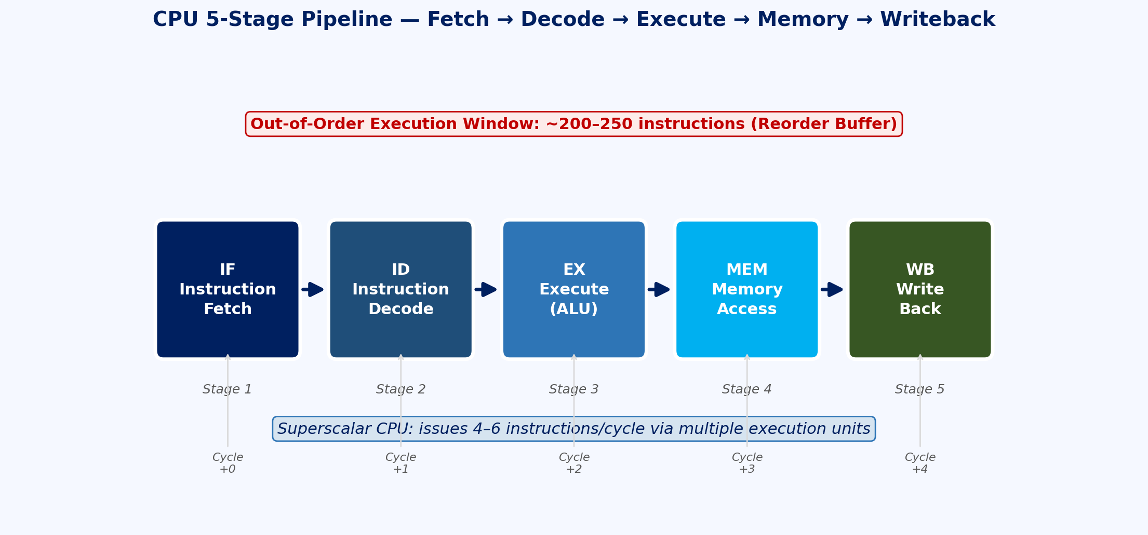
CPU Microarchitecture: The Building Blocks
Core Components
Fetch-Decode-Execute-Writeback pipeline stages
Superscalar execution: multiple execution units per cycle
Out-of-Order (OoO) execution for instruction-level parallelism
Branch predictor reduces pipeline stalls on conditional branches
Fig 1: CPU 5-Stage Pipeline

Slide 6
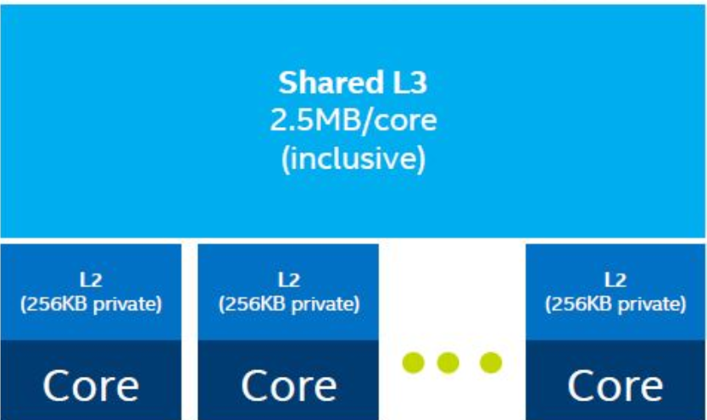
CPU Microarchitecture: The Building Blocks
Cache Hierarchy (Intel Xeon example)
L1: ~32 KB per core, ~4 cycle latency, per-core private
L2: ~256 KB per core, ~12 cycle latency, per-core private
L3: 30-60 MB shared, ~40 cycle latency, shared across cores
DRAM: GBs capacity, ~200+ cycle latency (the “memory wall”)
Ref: Patterson & Hennessy, “Computer Organization and Design,” 6th Ed. (2021)

Slide 7
CPU Microarchitecture: The Building Blocks
Modern CPU Specifications (AI Context)
AMD EPYC 9654: 96 cores, 384 MB L3, 12-ch DDR5
Intel Xeon Max 9480: 60 cores + HBM2e on-package
Peak FP32: ~4-6 TFLOPS (CPU) vs ~1000 TFLOPS (GPU)
Memory BW: ~300 GB/s (CPU DDR5) vs ~3.35 TB/s (H100 HBM3)
Key Insight
CPUs excel at serial, branchy, latency-sensitive workloads.
AI training/inference is a massively parallel GEMM problem.
Ref: Patterson & Hennessy, “Computer Organization and Design,” 6th Ed. (2021)

Slide 8
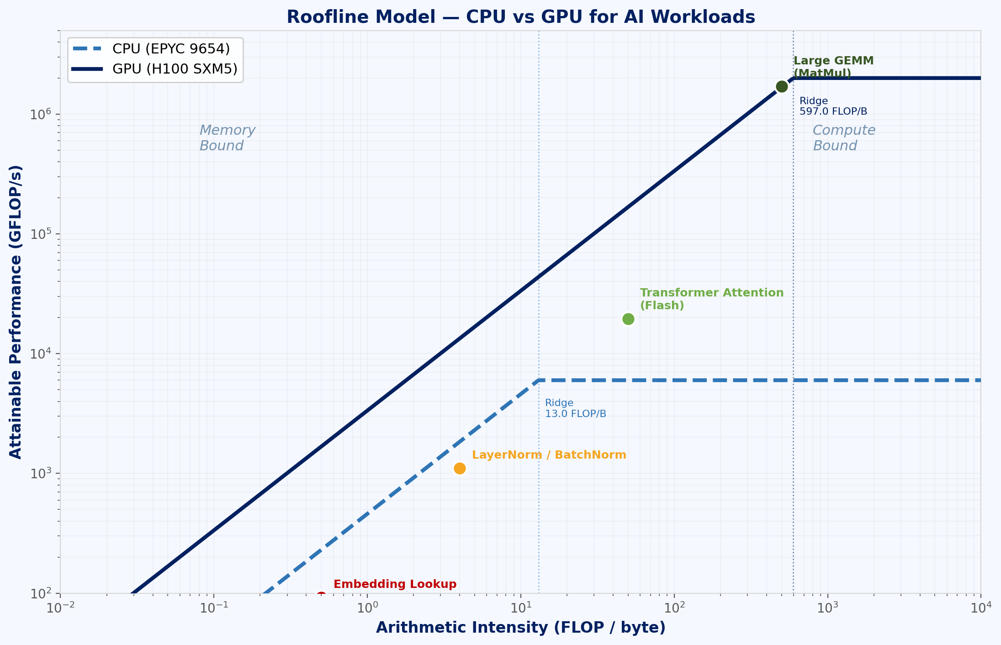
ILP, SIMD, and the Parallelism Gap
Fig 2: Roofline Model — CPU vs GPU for AI
Ref: Williams, Waterman, Patterson. “Roofline: An Insightful Visual Model.” CACM 2009

Slide 9
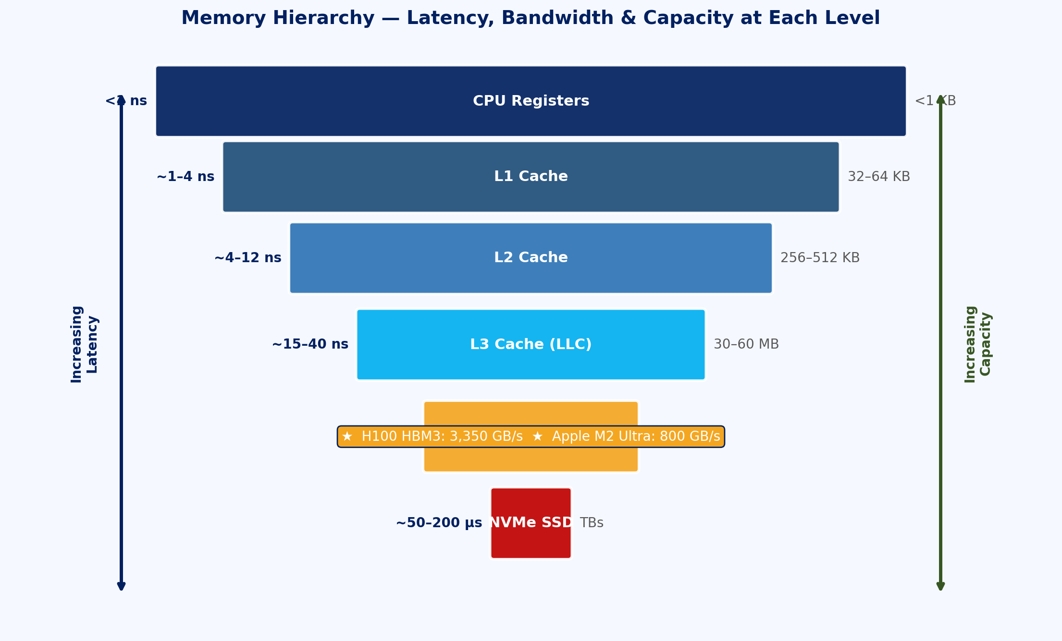
Von Neumann Bottleneck & the Memory Wall
Fig 3: Memory Hierarchy — Latency, Bandwidth & Capacity
Ref: Wulf & McKee, “Hitting the Memory Wall,” ACM SIGARCH 1995; Hennessy & Patterson, Turing Lecture 2018

Slide 10
CPUs in the AI Pipeline: Where They Still Excel
Pre/Post Processing: CPU’s Domain
Data ingestion, tokenisation, and augmentation are branchy and irregular - ideal for CPUs
OpenCV image decoding, librosa audio processing, NLTK/spaCy text parsing
Dataset shuffling, batching, and prefetching managed by CPU DataLoader workers
Model Components That Remain on CPU
Sparse operations (variable-length sequences, dynamic graphs in PyTorch)
Control flow in reinforcement learning environments (step(), reset())
ONNX Runtime on CPU: viable for lightweight models (<10M params) in production
Heterogeneous Computing Philosophy
CPU: orchestration, control flow, serial computations, IO management
GPU/Accelerator: massively parallel tensor operations (GEMM, Conv, Attn)
Always profile before offloading - PCIe transfer overhead can dominate for small ops
Key Metric: Use nvidia-smi to check GPU utilisation; if <60%, CPU is the bottleneck
Rule of Thumb: GPU-CPU data transfer at ~16 GB/s (PCIe 4.0 x16) vs 3.35 TB/s GPU memory
Ref: NVIDIA Nsight Systems; Raschka et al., “Machine Learning with PyTorch and Scikit-Learn” (2022)

Slide 11
Segment 1 Summary: CPU Architecture & AI Workloads
CPUs use deep pipelines, caches, OoO execution, and SIMD for latency-optimised serial computation
The memory wall and von Neumann bottleneck constrain CPU performance for data-heavy AI tasks
SIMD extensions (AVX-512, AMX) partially close the gap but cannot match GPU-scale parallelism
Arithmetic intensity determines whether a workload is compute-bound or memory-bound on any architecture
CPUs remain essential for data preprocessing, orchestration, and sparse/control-flow-heavy tasks in AI pipelines

Slide 12
Segment 2: Memory Hierarchy, RAM, Storage & Data Movement
How data flows from disk to compute units - and why this journey dominates AI system performance

Slide 13
Learning Objectives - Segment 2
01
Map the full data movement path from NVMe storage to GPU compute cores
02
Quantify bandwidth and capacity at each level of the memory hierarchy
03
Explain HBM (High Bandwidth Memory) and why it is critical for AI accelerators
04
Identify bottlenecks in DataLoader pipelines and apply pinned memory optimisation
05
Describe NUMA (Non-Uniform Memory Access) effects in multi-socket AI servers

Slide 14
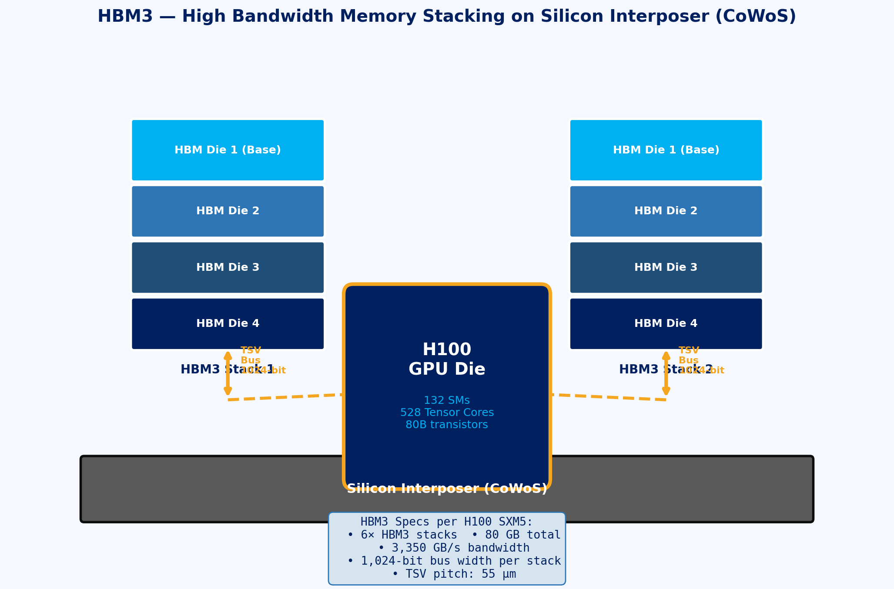
DRAM Fundamentals: DDR, LPDDR, and HBM
Fig 4: HBM3 Stacked Die Architecture on Silicon Interposer
Ref: Jedec HBM3 Standard JESD238; NVIDIA H100 Tensor Core GPU Architecture Whitepaper (2022)

Slide 15
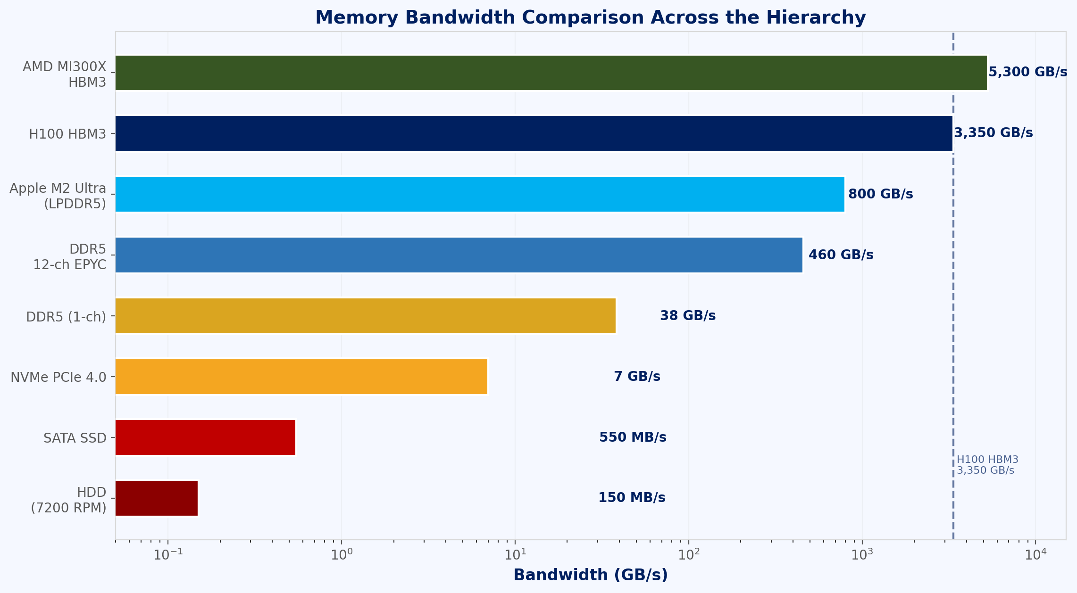
Storage Tiers & the Data Ingestion Pipeline
Fig 5: Bandwidth Comparison across Storage & Memory Tiers
Ref: PyTorch DataLoader docs; NVIDIA GPUDirect Storage Tech Brief (2022); MLPerf Storage Benchmark

Slide 16
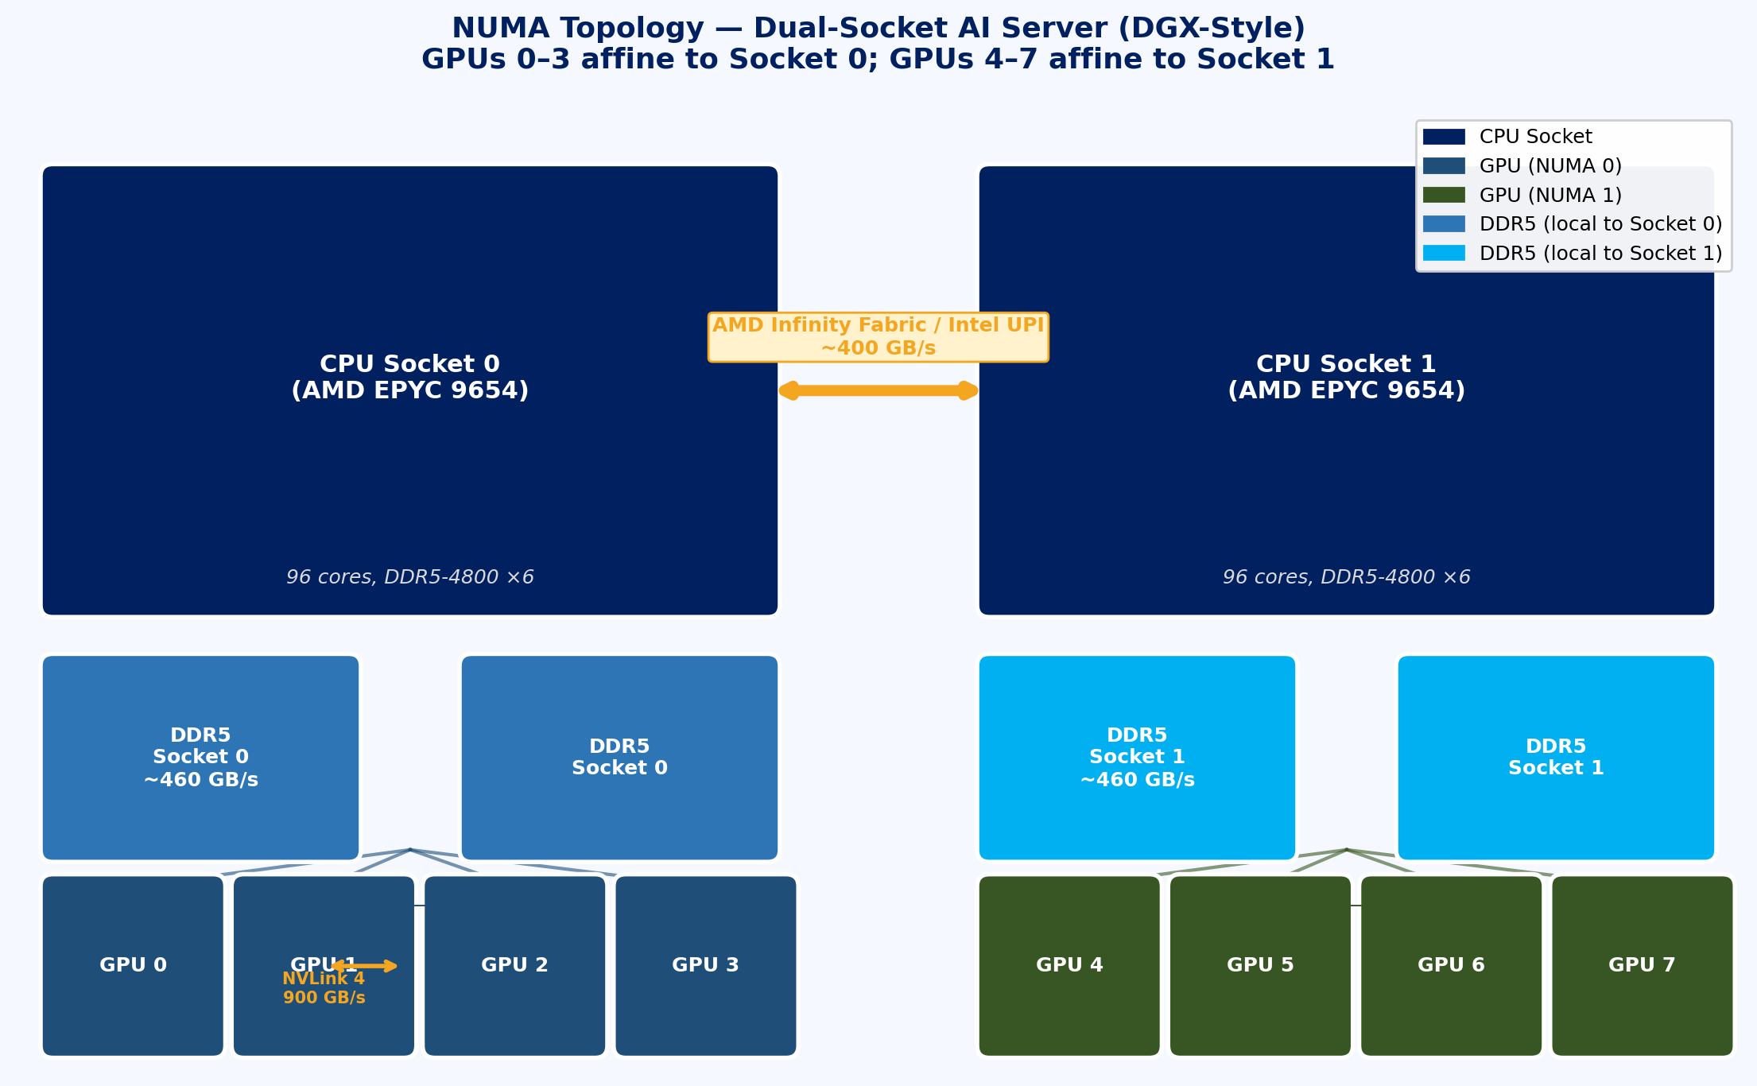
NUMA Architecture in Multi-Socket AI Servers
Fig 6: NUMA Dual-Socket Server Topology
Ref: AMD EPYC 9004 Architecture Guide; NVIDIA DGX H100 System Architecture (2023)

Slide 17
Data Movement Costs: The Hidden Performance Tax
Why Data Movement Matters More Than Compute
Moving 1 byte across PCIe bus costs ~700 pJ of energy vs ~1 pJ for a FP32 MAC on-chip
H100 peak compute: 3.958 PFLOPS (FP8); H100 system bandwidth (PCIe): 128 GB/s - 30,000x gap
Optimal AI system design minimises data movement, maximises data reuse in fast memory
Techniques to Reduce Data Movement
Operator Fusion: combine LayerNorm + Dropout + Activation into one GPU kernel (Flash Attention)
Tiling: partition large matrices to fit in L2/SRAM, enabling data reuse without DRAM accesses
Gradient Checkpointing: recompute activations during backward pass instead of storing them all
Prefetching: overlap data transfer with compute using CUDA streams and async copy
Quantifying Impact in Practice
Flash Attention v2 (Dao 2022): 3-5x speedup via tiled HBM access - memory, not compute, was the limit
Gradient Accumulation: accumulate gradients over N mini-batches to simulate large batch with small VRAM
Mixed Precision (BF16/FP16): halves memory bandwidth requirement vs FP32 - often 1.5-2x speedup
“The free lunch is over for compute. The next frontier is memory-efficient algorithms.”
- Adapted from Sutter (2005), applied to modern AI systems
Ref: Dao et al., FlashAttention-2, ICLR 2024; Rajbhandari et al., ZeRO, SC’20

Slide 18
Segment 2 Summary: Memory Hierarchy & Data Movement
Memory hierarchy spans registers (<1 ns) through DRAM (60 ns) to NVMe (100 us) - latency governs AI pipeline design
HBM3 (3.35 TB/s) vs DDR5 (460 GB/s per socket): on-chip bandwidth is 7x higher - keep hot data in GPU VRAM
NUMA topology determines which CPU cores and memory channels have lowest-latency GPU access - always pin affinity
DataLoader optimisation (pinned memory, num_workers, prefetch) is essential to prevent GPU starvation
Data movement energy cost dwarfs arithmetic cost - operator fusion, tiling, and mixed precision are first-order optimisations

Slide 19
Segment 3: GPU Fundamentals & Modern AI Accelerators
Inside the engines of modern AI: from thousands of CUDA cores to Tensor Cores and beyond

Slide 20
Learning Objectives - Segment 3
01
Describe the SIMT (Single Instruction Multiple Threads) execution model of GPUs
02
Explain the CUDA thread hierarchy: threads, warps, blocks, and grids
03
Identify the role of Tensor Cores in matrix multiplication acceleration
04
Compare NVIDIA H100, AMD MI300X, Google TPU v4, and Graphcore IPU architectures
05
Select appropriate accelerators for training vs. inference workloads based on specifications

Slide 21
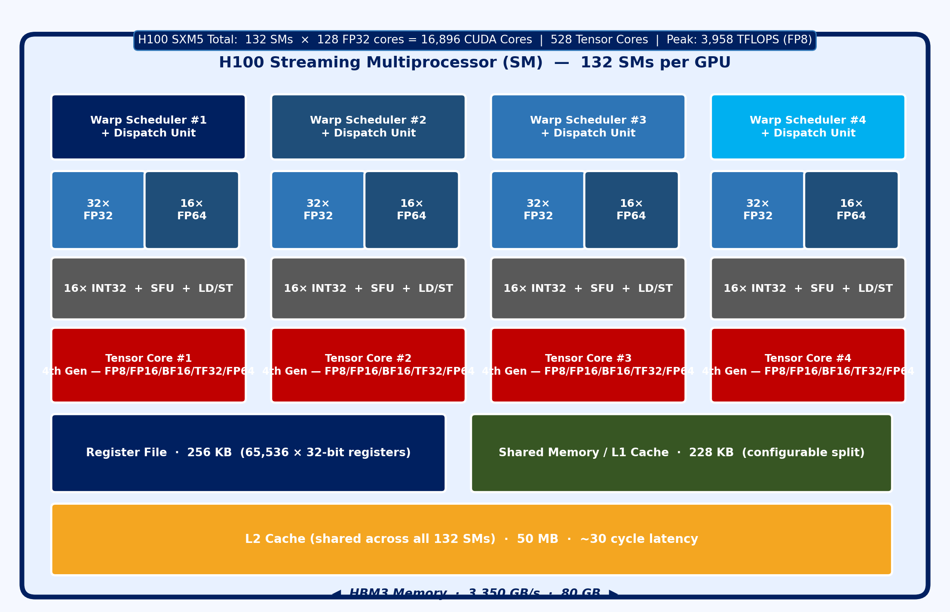
GPU Architecture: SIMT and the Streaming Multiprocessor
Fig 7: H100 Streaming Multiprocessor Architecture
Ref: NVIDIA H100 GPU Architecture Whitepaper (2022); Kirk & Hwu, “Programming Massively Parallel Processors,” 4th Ed.

Slide 22
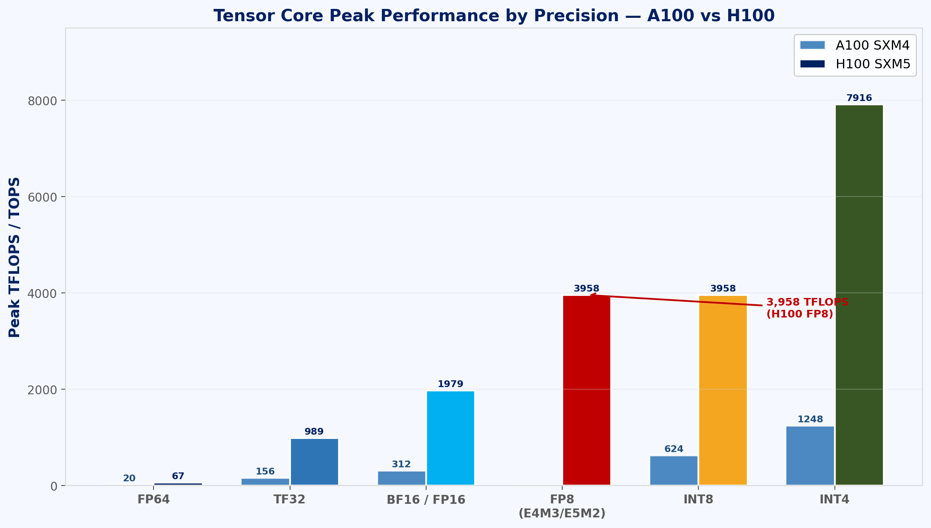
Tensor Cores: Accelerating the GEMM at the Heart of AI
Fig 8: Tensor Core Precision Modes & TFLOPS
Ref: NVIDIA Hopper Architecture In-Depth (2022); Micikevicius et al., Mixed Precision Training, ICLR 2018

Slide 23
Beyond NVIDIA: AMD, TPU, Graphcore and Custom Accelerators
AMD MI300X (2023)
13 chiplets (3nm CDNA3 + 6x HBM3): 1.307 PFLOPS FP16
192 GB HBM3 memory @ 5.3 TB/s - largest GPU VRAM available
ROCm software stack: PyTorch/JAX support via HIP (CUDA portability layer)
Best for LLM inference (huge model fits in single GPU VRAM)
Google TPU v4 (2021)
Custom ASIC: 275 TFLOPS (BF16), 32 GB HBM2e @ 1.2 TB/s
TPU Pod v4: 4096 chips interconnected via custom 3D torus network
Optimal for JAX/XLA workloads (TensorFlow, Flax), not general-purpose
Systolic array architecture: data flows through mesh of MACs without control overhead
Graphcore IPU (Intelligence Processing Unit)
1472 independent processor tiles with local SRAM (for graph neural networks)
BSP (Bulk Synchronous Parallel): compute phase alternates with communicate phase
Ideal for sparse, irregular workloads (GNNs, symbolic AI) - poor for dense GEMM
AWS Trainium & Inferentia (Custom ASICs)
Trainium2: 190.7 TFLOPS (FP16), optimised for AWS SageMaker training jobs
Inferentia2: 190 TOPS (INT8), purpose-built for low-latency inference serving
Accelerator Selection Guide
Large model training: H100 SXM or MI300X (highest HBM BW)
Cost-efficient training: A100 80GB or H100 PCIe clusters
Low-latency inference: Inferentia2, L40S, or quantised RTX 4090
Batch inference: A10G, L4, T4 (Google Cloud) - best performance/dollar
Ref: AMD MI300X Architecture Whitepaper (2023); Google TPU v4 Jouppi et al., ISCA 2023

Slide 24
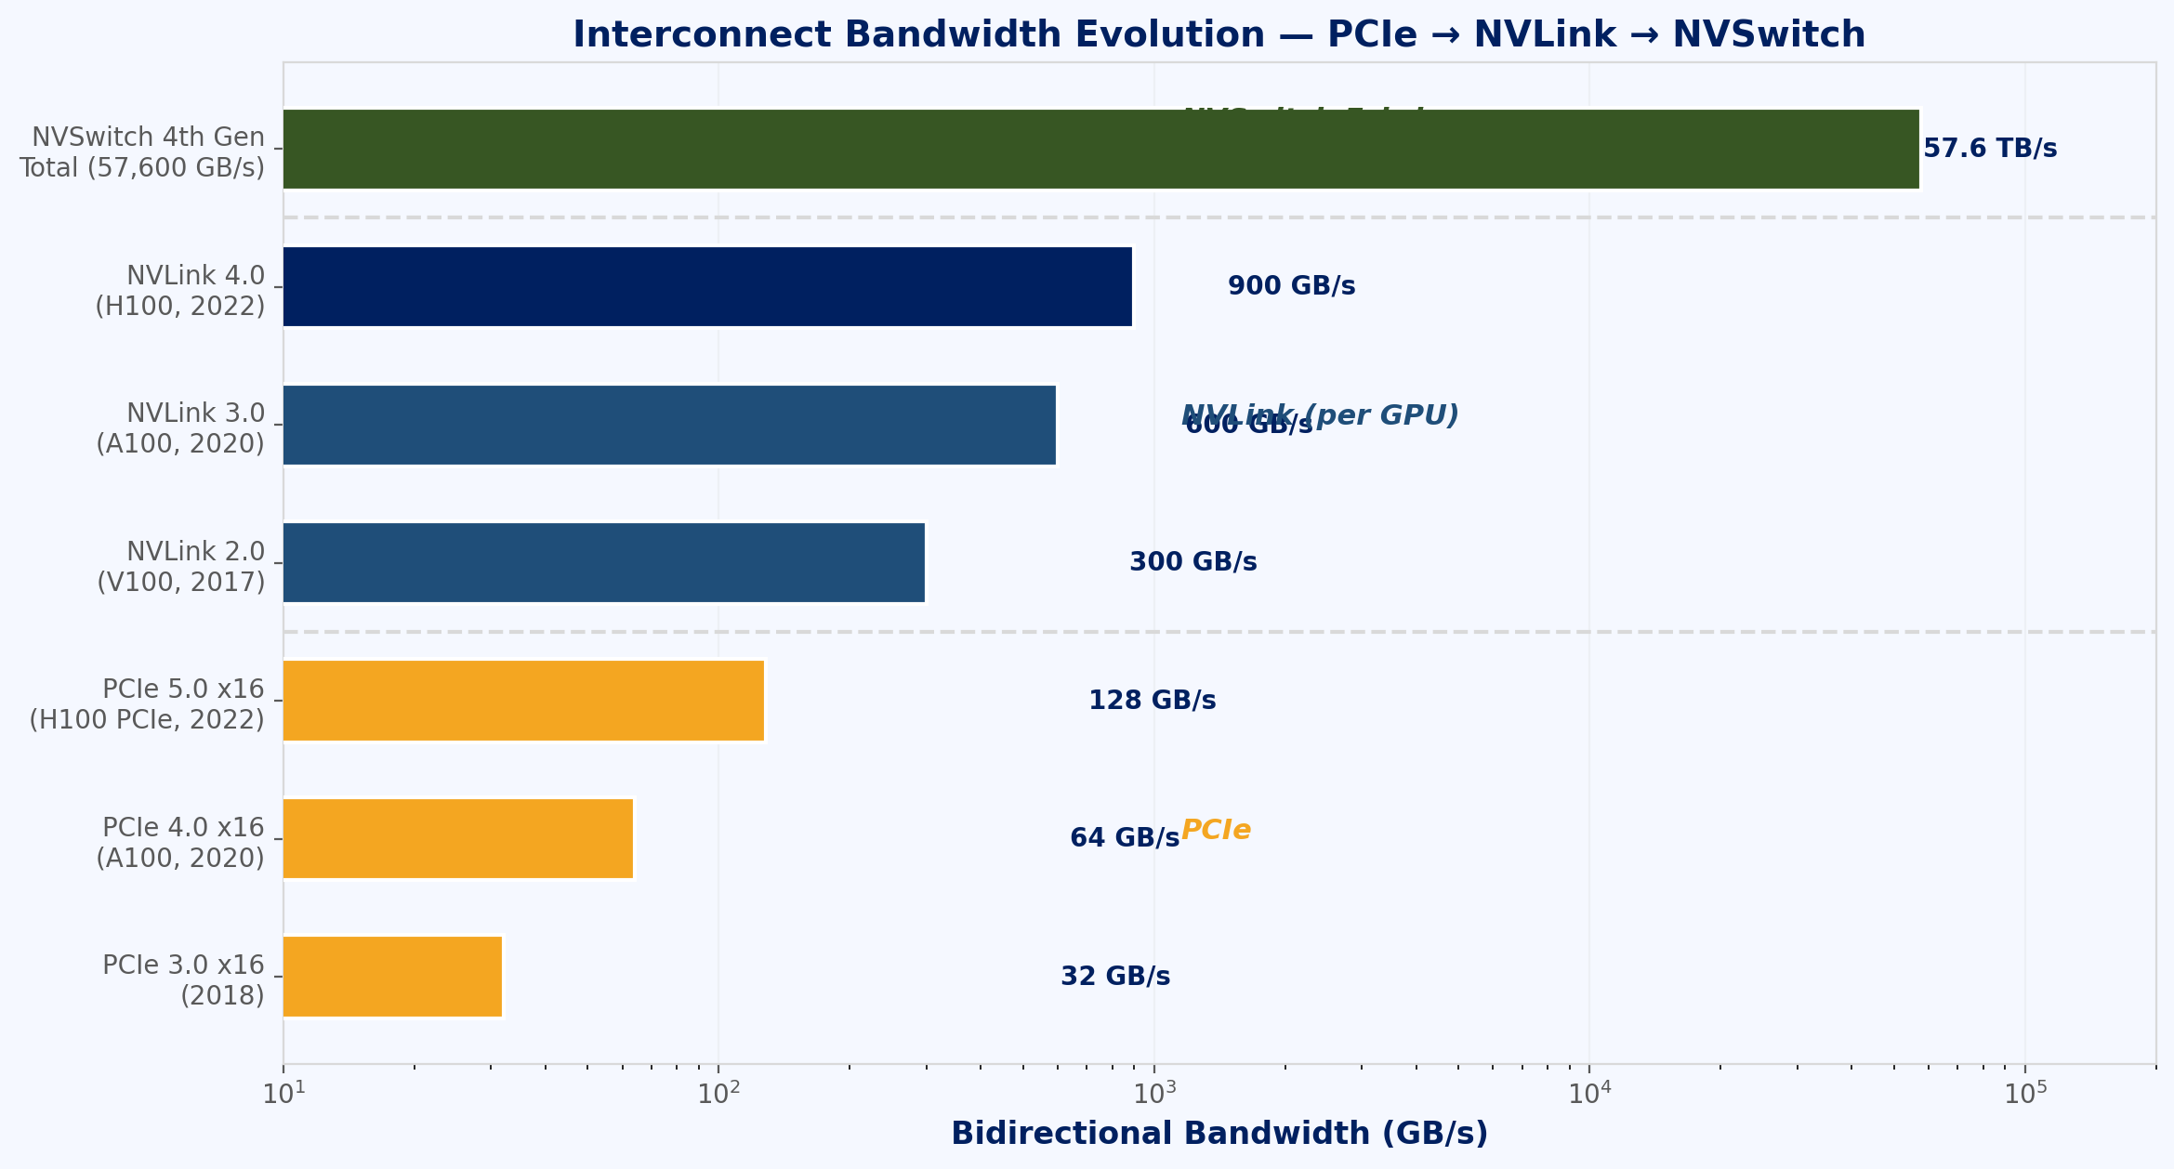
GPU Memory Management and VRAM Optimisation
Fig 9: Memory & Interconnect Bandwidth Comparison
Ref: Rajbhandari et al., “ZeRO: Memory Optimizations Toward Training Trillion Parameter Models,” SC’20

Slide 25
Segment 3 Summary: GPU Fundamentals & AI Accelerators
GPUs execute thousands of threads in warps (32) via SIMT; occupancy and warp scheduling hide memory latency
Tensor Cores perform matrix MACs per cycle: H100 reaches 3958 TFLOPS (FP8) - 600x vs single CPU core
HBM3 (3.35 TB/s) is the defining bandwidth advantage of the H100; AMD MI300X offers 192 GB / 5.3 TB/s
TPUs (systolic arrays), IPUs (tile-based), and cloud ASICs offer architecture diversity for specific workloads
ZeRO-3 sharding and gradient checkpointing are essential techniques for training beyond single-GPU VRAM limits

Slide 26
Segment 4: Interconnects - PCIe, NVLink and NVSwitch
The communication fabric that determines whether your multi-GPU cluster runs or crawls

Slide 27
Learning Objectives - Segment 4
01
Describe PCIe lane architecture and calculate peak bandwidth for Gen 4 and Gen 5
02
Explain why NVLink was invented and quantify its bandwidth advantage over PCIe
03
Understand NVSwitch as an all-to-all crossbar enabling full-mesh GPU communication
04
Identify the communication primitives used in distributed training (AllReduce, AllGather, ReduceScatter)
05
Apply the concept of communication-compute overlap to analyse distributed training efficiency

Slide 28
PCIe: The Universal Interconnect
Fig 10: PCIe Bandwidth by Generation
Ref: PCI-SIG PCIe 5.0 Specification (2019); NVIDIA GPUDirect RDMA documentation

Slide 29
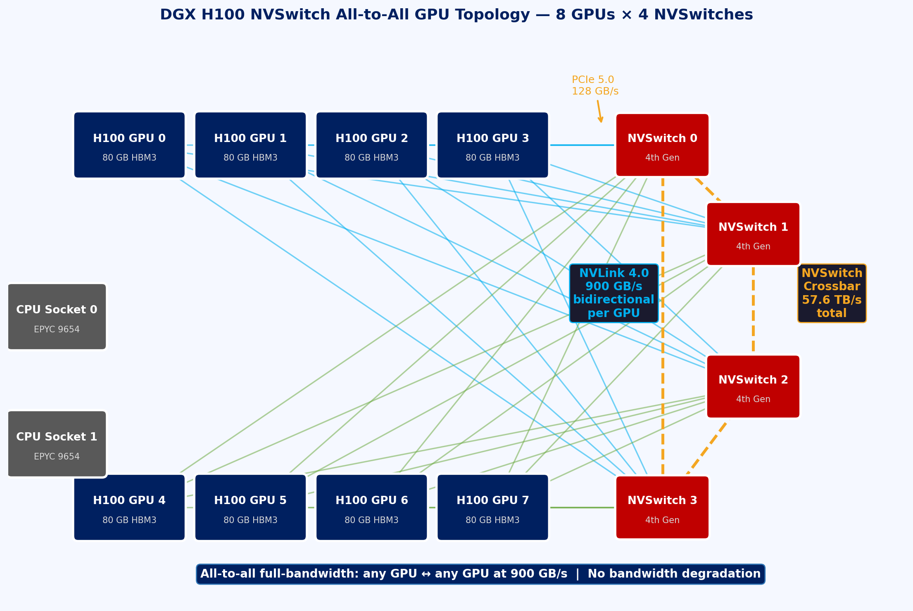
NVLink and NVSwitch: NVIDIA’s High-Bandwidth Interconnect Fabric
Fig 11: DGX H100 NVSwitch All-to-All GPU Topology
Ref: NVIDIA NVLink and NVSwitch Whitepaper (2023); NVIDIA DGX H100 Systems Architecture (2023)

Slide 30
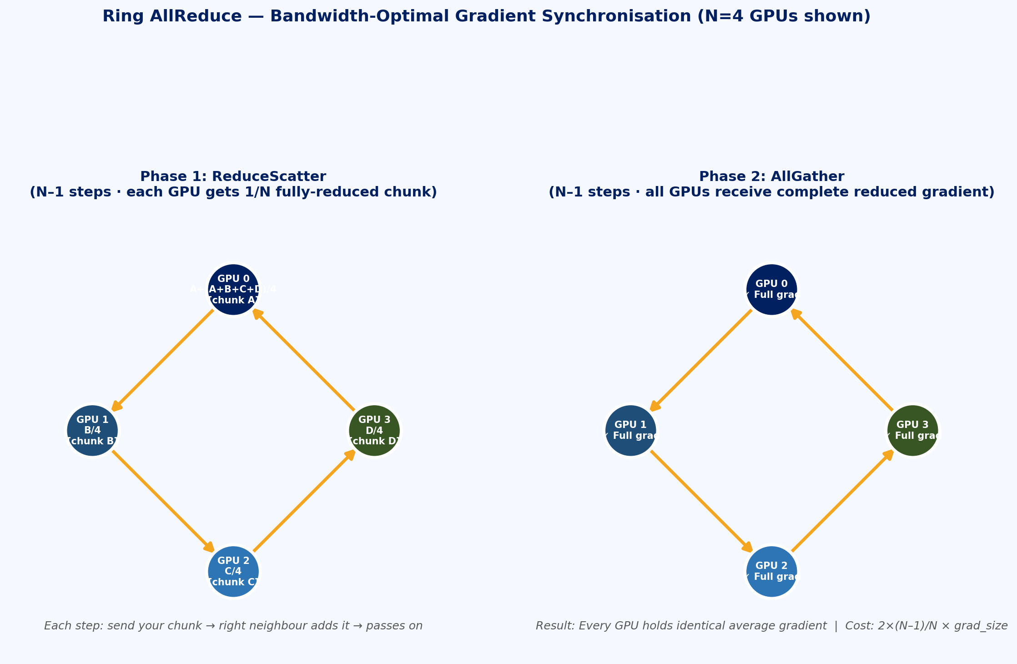
Collective Communication Primitives in Distributed Training
Fig 12: Ring AllReduce — Bandwidth-Optimal Gradient Sync
Ref: Patarasuk & Yuan, “Bandwidth Optimal AllReduce,” 2009; PyTorch DDP Paper, VLDB 2020

Slide 31
Network Topologies for Multi-Node AI Clusters
Fat-Tree Topology (Standard Data Centre)
3-tier Clos: ToR (Top of Rack) - Aggregation - Core switches
Full bisection bandwidth: any-to-any GPU communication at full line rate
Oversubscription ratio (2:1, 4:1) reduces cost but creates congestion at scale
Rail-Optimised Topology (NVIDIA Quantum-2 InfiniBand)
Each GPU connected to different spine switch; intra-node uses NVSwitch
Inter-node traffic spreads across multiple spine paths (load balancing)
NVIDIA Quantum-2: 400 Gb/s InfiniBand, 7,500 ports per fabric, <100 ns latency
Torus Networks (Google TPU, Frontier Supercomputer)
3D/4D torus: nodes arranged in multi-dimensional grid with wrap-around edges
TPU v4 Pod: 4096 chips in 3D torus - excellent for collective operations
AMD EPYC Frontier: 3D torus Slingshot-11 network, 200 Gb/s per node port
Choosing Interconnect for Your Cluster
Single-node 8-GPU: NVSwitch topology is sufficient for most training jobs
Multi-node <64 GPUs: 200 Gb/s InfiniBand or RoCEv2 with RDMA
HPC-scale (>1000 GPUs): InfiniBand HDR/NDR or proprietary (NVLink Network, Slingshot)
Benchmark: nccl-tests --op allreduce --minbytes 1M --maxbytes 16G to measure effective BW
Ref: Besta et al., “Demystifying the MLPerf Training Benchmark,” 2023; Top500.org Frontier System Profile

Slide 32
Segment 4 Summary: Interconnects - PCIe, NVLink & NVSwitch
PCIe 5.0 x16 provides 64 GB/s bidirectional - sufficient for single-GPU but a bottleneck for multi-GPU AllReduce
NVLink 4.0 delivers 900 GB/s per H100, with NVSwitch enabling full-mesh all-to-all at full bandwidth for 8-GPU nodes
Ring AllReduce is bandwidth-optimal: 2(N-1)/N x gradient_size per GPU regardless of ring size
NCCL with GPUDirect RDMA overlaps inter-node communication with backward computation via CUDA streams
Cluster topology (fat-tree, rail-optimised, torus) determines scalability - always benchmark with nccl-tests before optimising

Slide 33
Segment 5: AI Software Stack - OS, Drivers & Runtime Layers
The layered software architecture that connects your Python code to silicon transistors

Slide 34
Learning Objectives - Segment 5
01
Map the full AI software stack from user-space frameworks to kernel drivers
02
Explain the role of CUDA Runtime, cuDNN, cuBLAS, and NCCL in the NVIDIA stack
03
Describe GPU driver management, kernel modules, and CUDA version compatibility
04
Understand container runtimes (Docker, containerd) and NVIDIA Container Toolkit
05
Identify the key Linux kernel features leveraged by AI workloads (hugepages, cgroups, IOMMU)

Slide 35
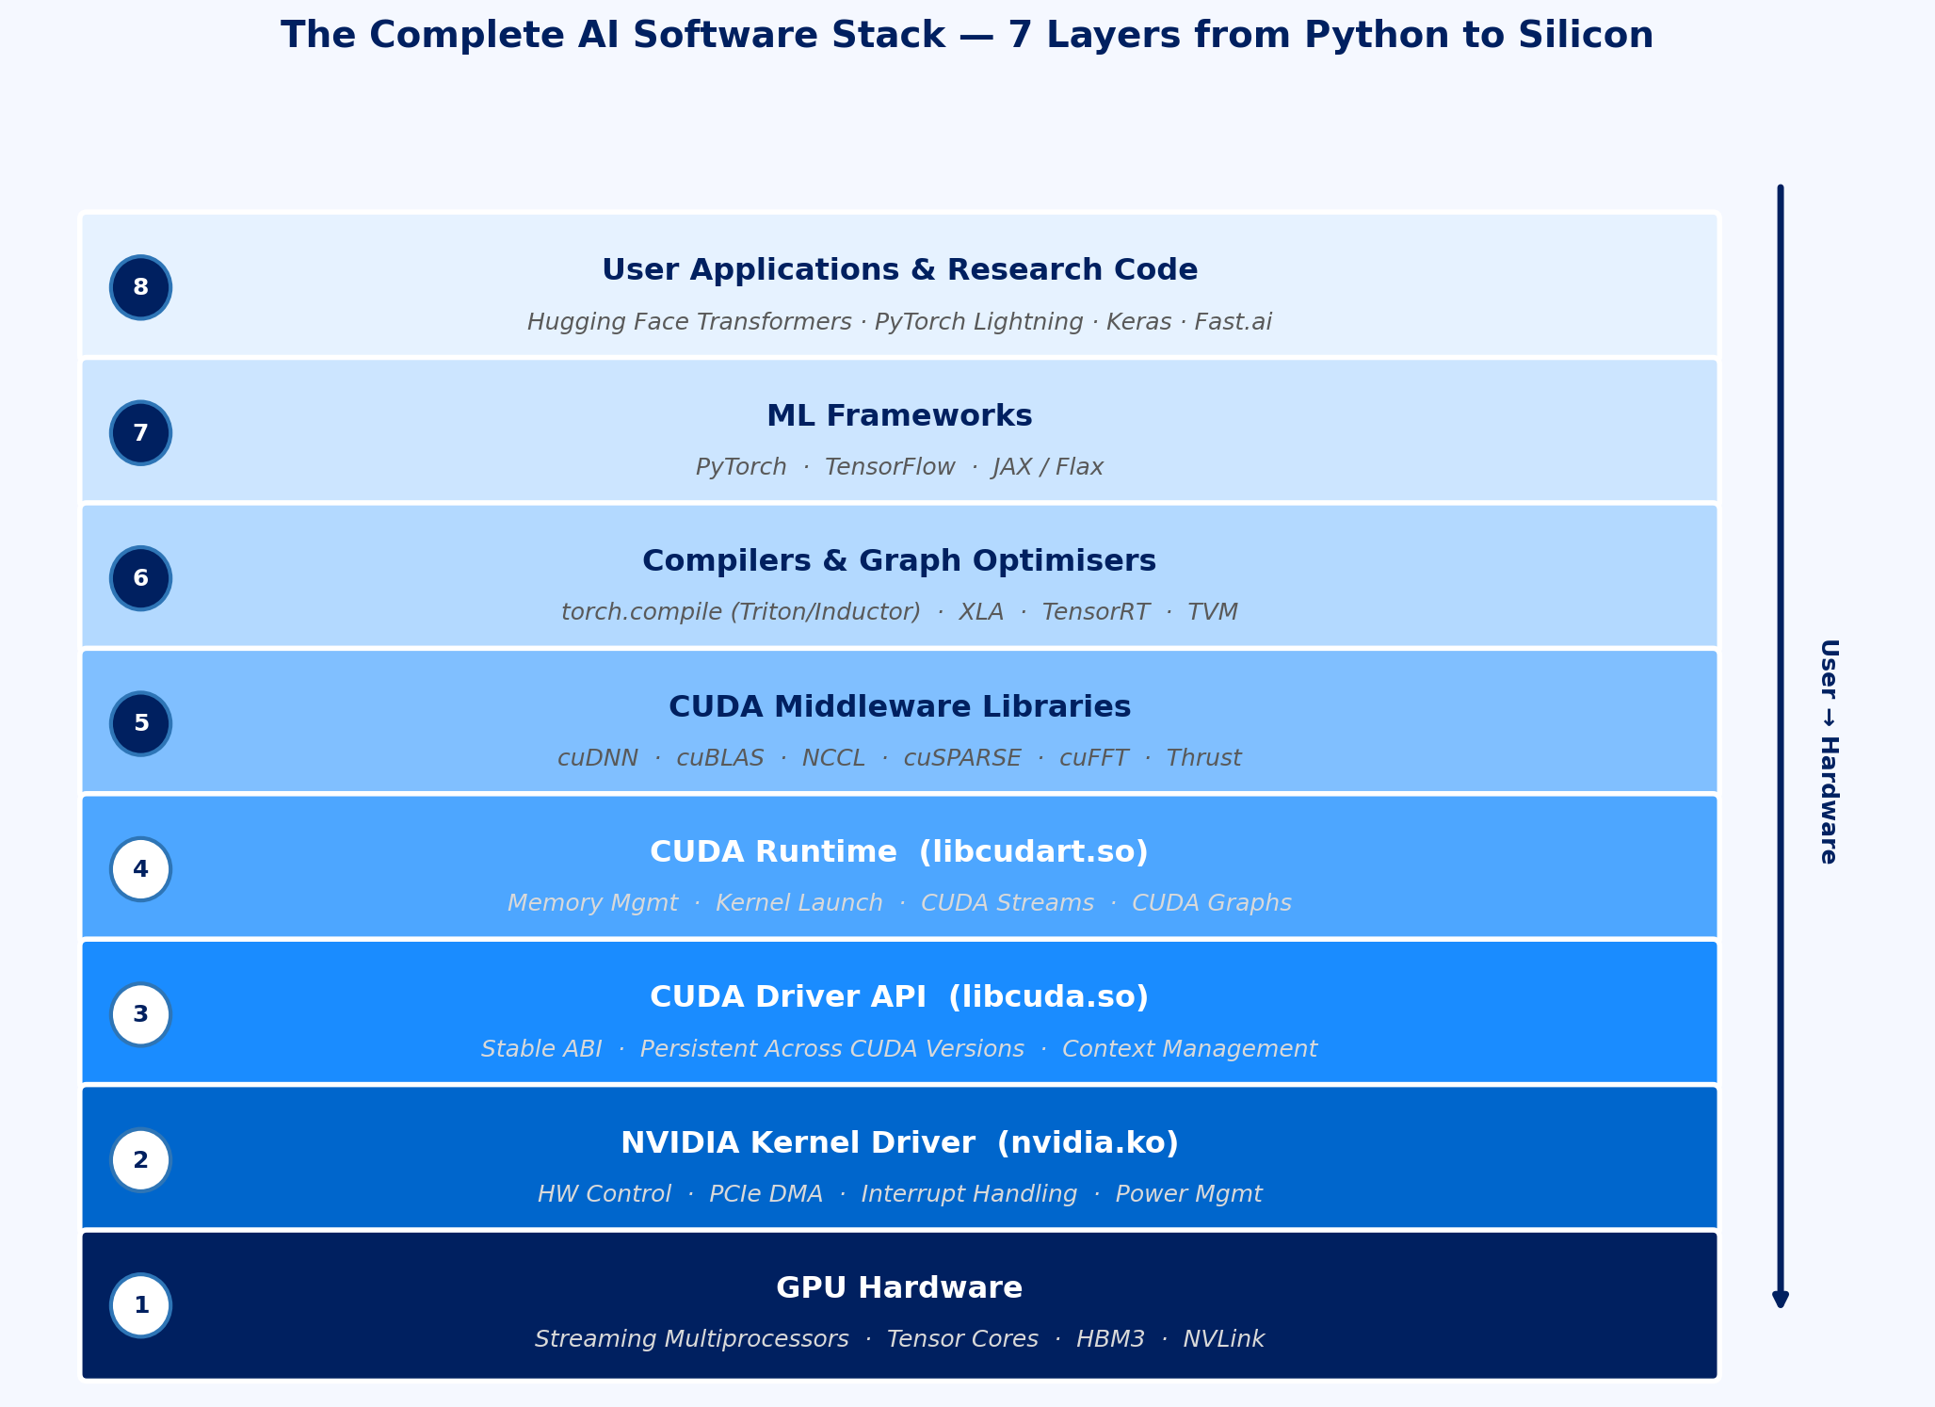
The Full AI Software Stack: Layer by Layer
Fig 13: The Complete AI Software Stack — 7 Layers
Ref: NVIDIA CUDA Programming Guide v12 (2024); CUDA C++ Best Practices Guide

Slide 36
CUDA Runtime, cuDNN, and cuBLAS: Under the Hood
CUDA Runtime: Memory and Execution Management
cudaMalloc / cudaFree: allocate/release GPU global memory (HBM)
cudaMemcpy / cudaMemcpyAsync: host-device transfers (sync/async with streams)
CUDA Streams: logical queues for ordering kernel execution and memory transfers
CUDA Graphs: capture and replay sequences of operations with reduced launch overhead
cuDNN: The Convolution and Attention Engine
Provides conv2d, bn, pooling, activation, dropout, RNN, MHA ops for DL
Heuristic algorithm selection: picks fastest kernel for given tensor shapes and hardware
Flash Attention integrated into cuDNN 8.9+ for memory-efficient attention
cudnnFind: benchmarks all algorithm options - call once, cache result, great for fixed-shape models
cuBLAS: The GEMM Backbone
SGEMM, DGEMM, HGEMM: single/double/half precision matrix-matrix multiply
cublasGemmEx: mixed-precision GEMM with Tensor Core acceleration
PyTorch torch.matmul() ultimately calls cuBLAS GEMM routines internally
CUDA version compatibility: CUDA 12.x requires driver version >= 525.85.12
Check: nvidia-smi shows driver version; nvcc --version shows CUDA toolkit version
Ref: NVIDIA cuDNN Developer Guide v8.9; cuBLAS Library User Guide; CUDA C++ Programming Guide

Slide 37
Linux OS Features for AI Workloads
Huge Pages
Default Linux page: 4 KB; Huge pages: 2 MB or 1 GB per TLB entry
Reduces TLB misses for large ML model weight tensors in CPU RAM
Transparent Huge Pages (THP): kernel auto-promotes pages (often enabled by default)
CUDA allocates GPU memory as large contiguous blocks benefiting from huge pages
cgroups v2 (Control Groups)
Hierarchical resource controller: CPU, memory, I/O, device access
Kubernetes uses cgroups to enforce GPU memory limits and CPU quotas per pod
memory.limit_in_bytes: prevent OOM from propagating across training jobs
IOMMU (Input-Output Memory Management Unit)
Translates device virtual addresses to physical addresses for DMA safety
Intel VT-d / AMD-Vi: required for GPU passthrough in virtualisation (KVM)
GPUDirect requires IOMMU in passthrough mode for peer RDMA
CPU Governor and Power Management
Set CPU governor to ‘performance’: cpupower frequency-set -g performance
Disable CPU C-states for lowest latency: avoids wakeup delay for DataLoader workers
NUMA balancing: disable when NUMA affinity is manually pinned (numactl)
NVIDIA Driver Management
nvidia-smi: monitor GPU utilisation, power, temperature, ECC errors
nvidia-smi -pm 1: enable persistence mode (keep GPU initialised between jobs)
nvidia-smi --auto-boost-default=0: disable boost for reproducible benchmarks
DCGM (Data Centre GPU Manager): health checks, profiling, field injection for testing
System Configuration Checklist
1. Set performance governor & disable C-states
2. Enable hugepages (vm.nr_hugepages=1024)
3. Set GPU persistence mode (nvidia-smi -pm 1)
4. Verify NVLink topology (nvidia-smi topo -m)
Ref: Red Hat Enterprise Linux Performance Tuning Guide; NVIDIA DCGM Documentation (2023)

Slide 38
Container Runtimes and the NVIDIA Container Toolkit
Why Containers for AI?
Reproducible environments: exact CUDA, cuDNN, Python, framework versions pinned in image
Isolation: multiple research groups share the same hardware without conflicts
Portability: same container runs on local DGX, cloud A100, or CI/CD pipeline
NVIDIA Container Toolkit (nvidia-container-toolkit)
OCI hook: intercepts container creation, injects GPU device files and driver libraries
Mounts /dev/nvidia* devices, libcuda.so, and GPU management daemons into container
docker run --gpus all: exposes all GPUs; --gpus ‘device=0,1’ for specific GPUs
No need to install CUDA inside container - driver on host + CUDA runtime in image
NGC (NVIDIA GPU Cloud) Container Registry
Pre-built, optimised containers: PyTorch, TensorFlow, TensorRT, Triton
nvcr.io/nvidia/pytorch:24.04-py3 - monthly-updated, benchmarked on DGX hardware
Always prefer NGC containers for production: includes FlashAttention, TransformerEngine pre-installed
Container Runtime Overhead
Docker/Podman overhead: <1% for GPU compute workloads (host drivers pass through)
Startup time: container import may take 10-30 s for large NGC images (>20 GB)
Volume mounts: always mount datasets as volumes (-v /data:/workspace/data), not inside image
Next week: We will build and run GPU-enabled containers end-to-end in the lab session
Ref: NVIDIA Container Toolkit Documentation; NGC Catalog at catalog.ngc.nvidia.com

Slide 39
Segment 5 Summary: AI Software Stack
The AI software stack has 7 layers: frameworks → compilers → cuDNN/cuBLAS → CUDA Runtime → Driver → Kernel → Hardware
cuDNN provides conv/attention primitives; cuBLAS provides GEMM - PyTorch calls both transparently
CUDA Streams enable async data transfer + kernel execution overlap; CUDA Graphs reduce kernel launch overhead
Linux performance tuning (hugepages, cgroups, CPU governor, IOMMU) is prerequisite for consistent AI benchmarks
NVIDIA Container Toolkit injects GPU access into Docker containers - NGC images are the standard for reproducible AI environments

Slide 40
Thank you!

